Slide 1
2-Collecting tubules &Ducts
_They have different embryological origins, are about 20 mm long and have three recognize regions (cortical, medullary and papillary.
_The distal convoluted tubules empty in to the collecting tubules.
_The collecting tubules extend in to the renal medulla and merge to form the large papillary ducts of Bellini that empty in to the calyces.
_The smaller tubules are lined with simple cuboidal epithelium.
_As they approach the papillary ducts, the lining becomes columnar and becomes transitional toward the duct opening.

Slide 2
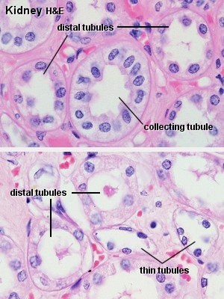

Slide 3
Ureter
Tube about 3-4 mm in diameter, is approximately 25-30 cm
long and pierces the base of urinary bladder.
_The ureters are hollow tubes consisting of :
1- Inner mucosa
-Transitional epithelium and lamina propria
2- Middle muscular layer
-Longitudinal and circular bands of smooth muscle
3- Outer connective tissue layer
-Continuous with fibrous renal capsule and peritoneum

Slide 4
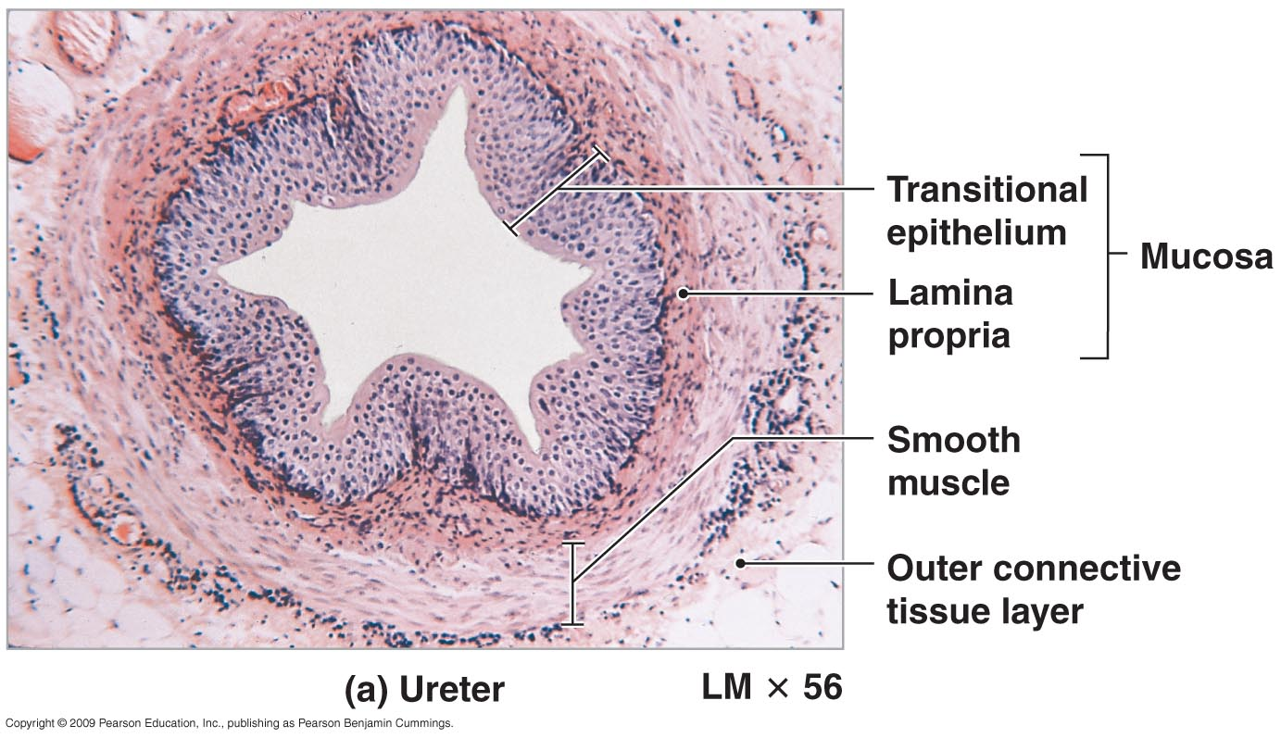
Urine Transport, Storage, and Elimination
Figure 26–19a The Histology of the Organs That Collect and Transport Urine.

Slide 5
_ The mucosa :
-appears as several folds, witch project in to the lumen when the ureter is empty, but are absent when the ureter is distended.
-type of epithelium is transitional epithelium lining, three to five cell layers in thickness, overlies layer of dense irregular fibro elastic c.t which constitutes the lamina properia.
-basal lamina is separated the epithelium from the lamina propria.

Slide 6
_The muscularis:
-Composed of two predominantly in separable layers of smooth muscle cells .
-the arrangement of the layers is the following the outer layer is arranged circularly and the inner layer is longitudinally.
-the arrangement is true for the proximal two thirds of the ureter, but in the lower third near the urinary bladder has outer longitudinal, middle circular and inner longitudinal.
-the proximal and distal terminal of ureter are blends with the capsule of the kidney and c.t of the urinary bladder respectively.

Slide 7
-the urine pass to the urinary bladder by muscular contraction of the ureteric wall establishes peristalsis-like waves.
-the ureter pierce the posterior aspect of the base of the bladder, a valve-like flap of mucosa over each ureteric orifice, preventing regurgitation of urine from the bladder back in to ureters.
_Urinary Bladder
Is reservoir for urine its wall is folded when it is empty, become smooth and thin in full bladder.
The wall is composed of :
-Mucosa
-Muscle coat
-Adventitia

Slide 8
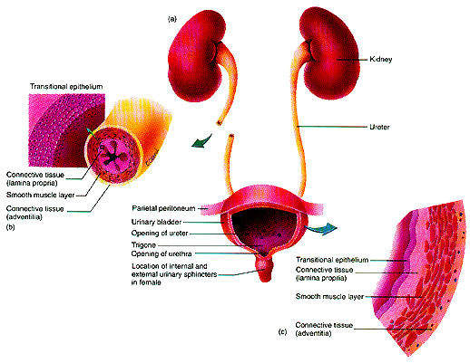
The Final Common Pathway
Urethra routed differently in males and females – see chapter 28

Slide 9
_The mucosa
-the lining epithelium is transitional have the ability to change, in empty bladder it is about( 5-6) layers of cells, but in full bladder it becomes (3-4) layer of cells and the outer most layer become squamus.
-the superficial cells of epithelium called (facet cell), responsible for the osmotic barrier between urine and lamina propria, they are hold together by desmosomes and tight junctions.
-the triangular region of the bladder, whose apices the orifices of two ureters and the urethra, is known as the trig one.
-the lamina propria contains no glands except at the region surrounding the urethral orifice, where mucous glands may be found.

Slide 10
_The muscular coat of the urinary bladder is composed:
Smooth muscle fibers run in many direction but near the neck of bladder the muscle arrange in three layers =inner and outer run longitudinally, the middle run circularly, the middle circular layer forms the internal sphincter muscle around the internal orifice of the urethra.
_The adventitia :
The adventitia of bladder is composed of dense irregular collgenous type of c.t containing amount of elastic fibers.

Slide 11
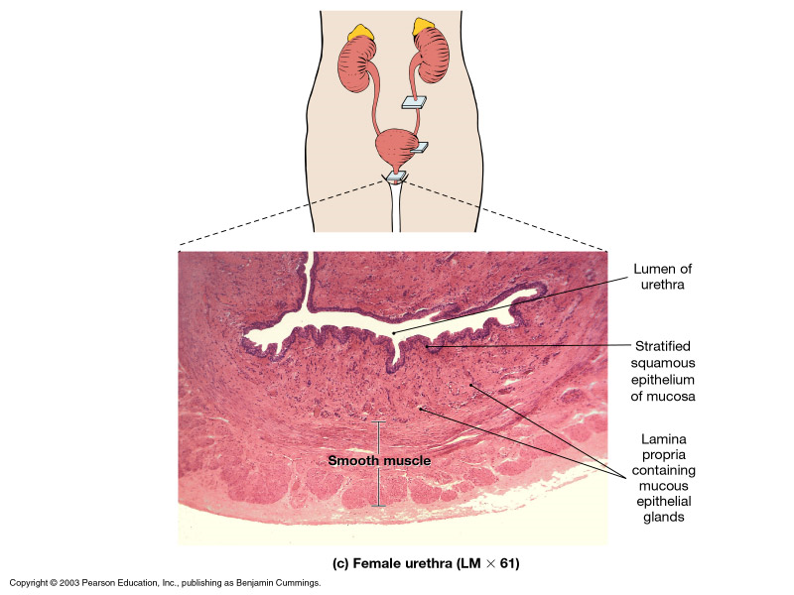

Slide 12
Urethra
-Fibro muscular tube which communicates with outside, permitting elimination of urine from the body.
-skeletal muscle fiber from the external sphincter surrounding the urethra, these muscle permits voluntary control of micturition.
-the urethra of male is longer than of the female and has a dual function, action as a route for urine as well as semen.
_Female urethra :
-extend from the urinary bladder to the external urethral
orifice just above an anterior to the opening of the vagina.
it is about 3-5 cm long lined by transitional epithelium, in mid - portion is pseudo stratified squamus epithelium.
-There is external striated muscle sphincter.

Slide 13
_ Male Urethra
Is the terminal part for both urinary and genital system, about 20 cm long has three segments are named according to the structures through which it passes:
-Prostatic urethra:
About (3-4) cm long from the neck of bladder through prostate gland, lined by a transitional epithelium and receives the opening of many tiny ducts of the prostate.
-Membranous urethra:
About (1-2) cm long extend from apex of prostate gland to the bulb of penis, it is lined by stratified columnar epithelium , it is surrounded by external sphincter of skeletal muscle.

Slide 14
-Penil (spongy) urethra:
Is extend for about (15) cm through penis surrounded by corpus spongiosum lined by pseudo stratified or stratified columnar except at opening it is stratified squamous epithelium.
Lamina propria of all three region is composed of a loose fibro elastic connective tissue with rich vascular supply.

Slide 15
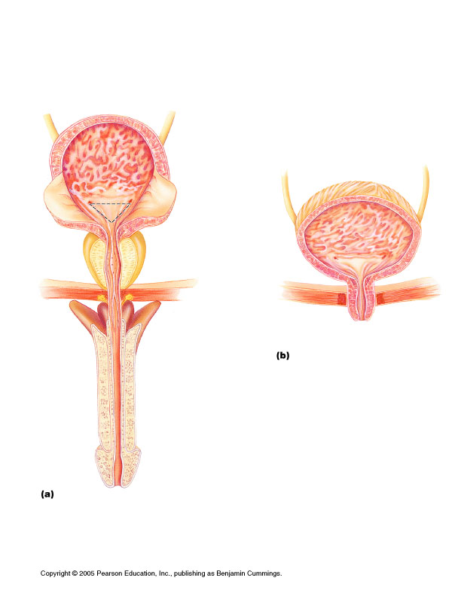
Males: urethra has three regions (see right)
_________trigone
1. Prostatic urethra__________
2. Membranous urethra____
3. Spongy or penile urethra_____
female

